Slide 1
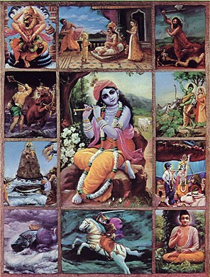
Dasa Avatars of Krishna
Dasa means 10
Ten avatars are special
Lord Krishna is the
source of all avatars
Krishna appears once
in a day of Lord Brahma
(4.32 Billion years!)

Slide 2
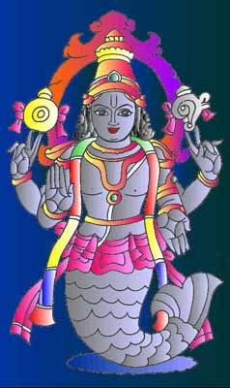
1. MATSYA Avatar
Saved the Vedas from the demons.

Slide 3
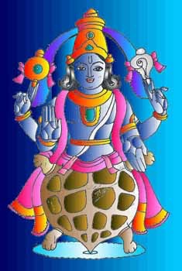
2. KURMA Avatar
Supported Manthara hill and helped the devatas to get nectar.

Slide 4
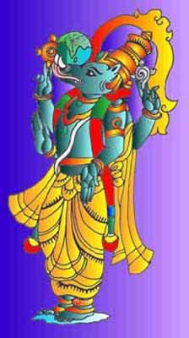
3. VARAHA Avatar
Came as a boar and killed Hiranyaksha and rescued Bhudevi

Slide 5
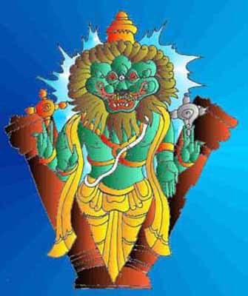
4. NARASIMHA Avatar
Came as Half-man and Half-Lion, He killed Hiranyakasipu and rescued Prahlada.

Slide 6
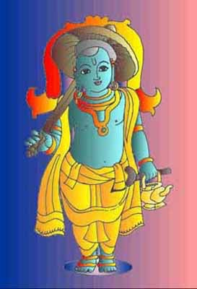
5. VAMANA Avatar
Came as a dwarf and sent Bali Maharaj to Patala loka and rescued demigods.

Slide 7
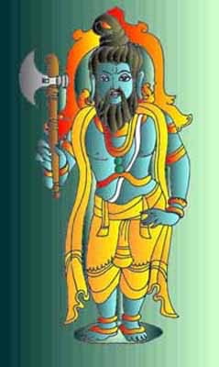
6. PARASURAMA Avatar
Came as a ferocious warrior and killed all the bad kings.

Slide 8
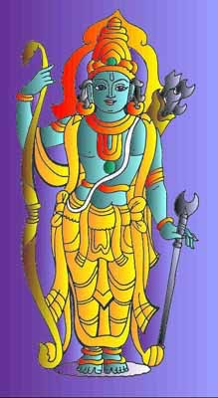
7. RAMA Avatar
Came as Rama and killed Ravana and rescued Sita Devi.

Slide 9
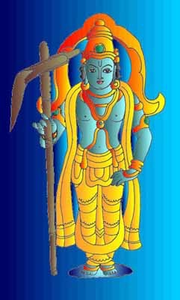
8. BALA RAMA Avatar
Accompanied Lord Krishna who is the source of all avatars.

Slide 10
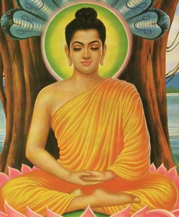
9. BUDDHA Avatar
(NOT Gautama Buddha)
Came to teach Ahimsa (no killing)

Slide 11
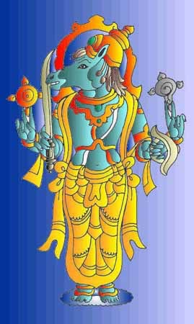
10. Kalki Avatar
He will come at end of Kali-Yuga and kill all the bad leaders and save the world.

Slide 12
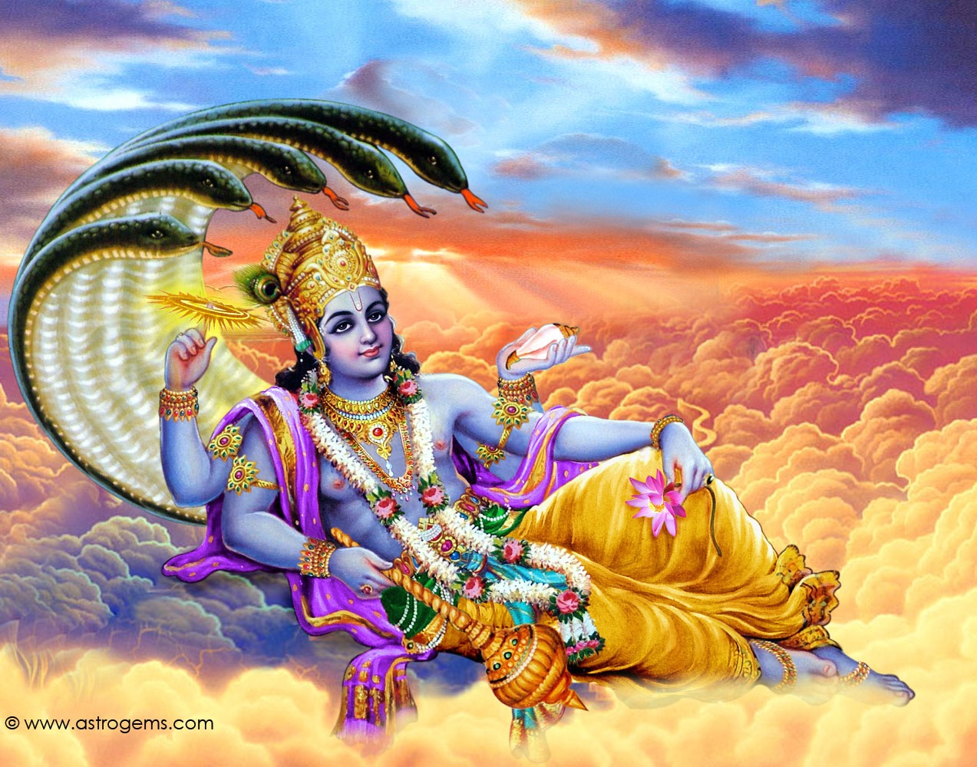
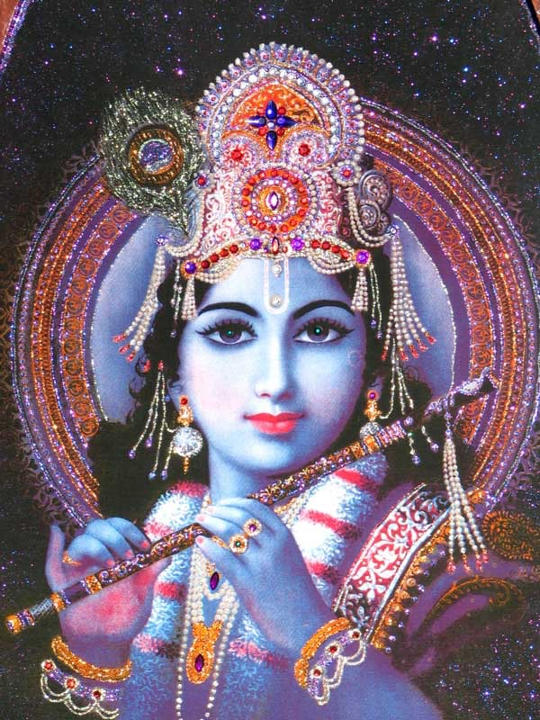
THANK YOU!

